Slide 1
Construction of binary tree from traversals

Slide 2
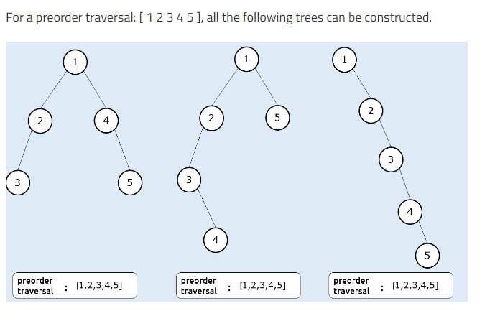
Constructing BT from preorder traversal

Slide 3
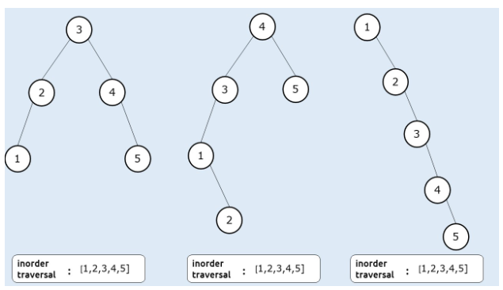
Constructing BT from inorder traversal

Slide 4
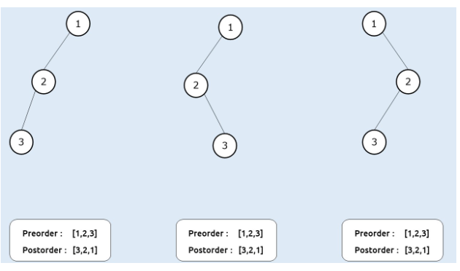
Constructing BT from preorder and postorder traversal

Slide 5
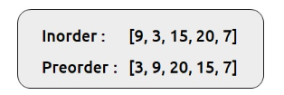
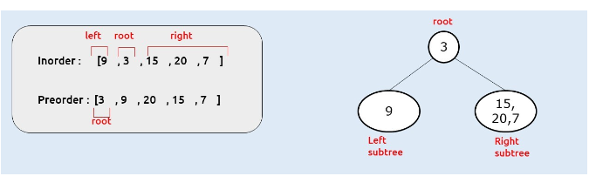
Using preorder and inorder traversal
Step 1

Slide 6
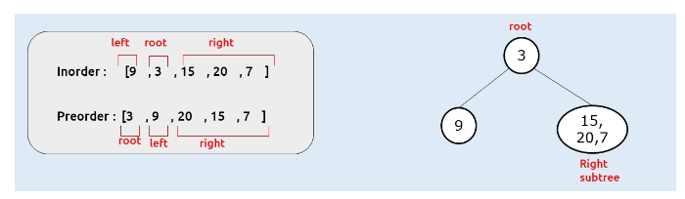
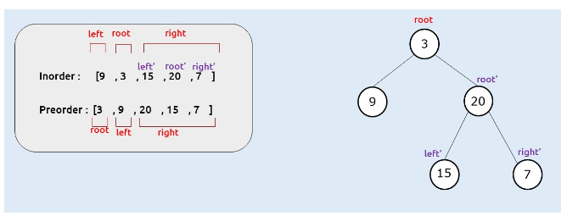
Using preorder and inorder traversal
Step 2
Step 3

Slide 7
Examples
Example 1
Preorder {1,2,4,5,7,3,6,8}
Inorder {4,2,7,5,1,8,6,3}
Postorder {4,7,5,2,8,6,3,1}
Example 2
Preorder {A,B,D,C,E,G,F,H,I}
Inorder {D,B,A,E,G,C,H,F,I}
Posorder {D,B,G,E,H,I,F,C,A}
Example 3
Inorder {A / B * C * D + E}
Preorder {+ * * / A B C D E}
Postorder {A B / C * D * E +}

Slide 8
Key takeaways
We cannot construct a unique binary tree using only one traversal
We cannot construct a unique binary tree using preorder and postorder traversal.
We can construct a unique binary tree using inorder traversal and preorder traversal or using inorder and postorder traversal.

